Slide 1
Safeguarding children under 1 from non-accidental injury
Child Safeguarding Practice Review Panel

Slide 2
About the review
Babies under 1yrs are subject to more SINs than any other group – 35% of the total
Since July 2018, the Panel has been notified of the death or serious harm of 257 babies under 1 year old through non-accidental injury.
Rapid reviews for these babies often identify the father or male carer as ‘invisible’ or 'hidden' - yet they are more often likely to be the perpetrator
So, we know the least about the biggest source of risk to babies

Slide 3
"The Myth of Invisible Men"
Questions for the review to answer:
‘Looking at cases of non-accidental injury (NAI) in infants under the age of 1, how well does the safeguarding system understand the role of the father/male carer?’
‘How can the safeguarding system be more effective at engaging, assessing and planning for and with men in the protection of children (or those for whom they have a parenting responsibility)?’

Slide 4
Methodology
In-depth fieldwork research into cases involving 23 babies that have been notified to the Panel, holding meetings with 322 practitioners and managers.
A review into the research literature by the Fatherhood Institute.
A series of roundtable discussions and one-to-one meetings with key stakeholders.
Interviews with eight male perpetrators who are currently serving a prison sentence for harming babies.
“The Myth of Invisible Men” – published 16th September 2021 + separate reports on:
      Fieldwork Review
      Literature Review
      Psychologist Report - Interviews with Men

Slide 5
The review in numbers
92
Of the 257 incidents notified to the Panel since July 2018, we looked at 92 eligible cases
(23 of which were selected for the fieldwork).
Of the 92 cases…
At the time of the abuse:
45 known only to universal services
24 known to early help
12 ‘children in need’
11 child protection plans
In terms of ethnic background:
66 White British
6 Asian
3 BAME
3 mixed ethnicity
In terms of risk factors:
59 featured domestic abuse
32 featured mental health problems for fathers
30 featured young parents
5 parents were care leavers
*81 living with birth father at the point of the abuse

Slide 6
Key findings
Prevalence:
Men are more likely to be perpetrators of death and harm (especially abusive head trauma) in range of 2:1 – 10:1
Fathers outnumber step-fathers as perpetrators – but considerably less step-fathers for under 1yrs
Boys much more likely to be victims (c56%-44%)
The men concerned:
Experiences of adversity in childhood
Substance abuse, especially use of drugs, is substantial and has to a large degree been normalised – it is described rarely analysed
Mental ill health, not always diagnosed but histories of ADHD, anger management issues, anxiety and depression.
The co-existence of domestic abuse and the fact that some men mitigate their difficulties with others through a rapid default to aggression and controlling behaviour.

Slide 7
Key findings
Contextual factors:
Living with the pressures of poverty, mounting debts, deprivation, worklessness, racism
Being a young parent and/or care leaver. Nearly 40% of the cases in the fieldwork cohort involved very young parents.
Violent acts – not necessarily violent men or men with histories of violence

Slide 8
Key finding
No one single indicator:
Abuse occurs in the coming together of challenging personal histories, levels of current substance misuse and mental ill-health and ‘external’ pressures and stresses - when responding to ’normal’ parenting demands…crying, illness, sleeplessness etc

Slide 9
Key Findings
Universal provision
Of the 92 cases in our original cohort, 49% were known only to universal service provision and a further 26% were known only to early help services.
We found men, keen to be involved, sharing difficulties about being included
Men who are less keen but are more vulnerable and might present risk are ’enabled’ not to be involved
While maternal health and wellbeing are, and should be, the main focus of maternity services, insufficient attention to engaging men often means that support to enable them to be active and confident fathers is limited.

Slide 10
Key Findings
Universal provision
Strategy and Practice
The role of and need to involve fathers remains unstated – Better Births describes need to focus on needs of ‘women, babies and their families’
If men are not specified in key policy documents, we cannot be confident they will be included
Commissioning of HV from NHS to LA not an issue
In 2015, research found that ‘...there is little evidence that the importance of engaging fathers is reflected in health visitor training or that primary care services are wholly embracing father-inclusive practice’
“The man is not on my caseload’ - a health visitor in our review

Slide 11
Key Findings
Information Sharing and Information Seeking
Information sharing between different parts of the health service is a problem – e.g. risks factor known by GPs not shared with Midwives or HVs – as well as across the wider system
A lack of patient record integration across parts of the health service exacerbate the knowledge gaps
Some of the risk issues may only be known by GPs who need consent to share information
Impact of GDPR other than under S47 a problem? Or leadership and culture?
Evidence of inconsistency in multi-agency front door responses and what is/is not shared
Evidence of information not being sought and whole pictures not being seen

Slide 12
Key Findings Specialist services
“Every time I spoke to my social worker, I felt like screaming – I am not invisible, I am right here willing and able to care for my son”
The involvement of men is no more evident in key statutory children’s services, particularly children’s social care, than it is in universal services.
This finding is supported by other research:
      fathers are invited to child protection conferences only 55% of the time
      known violent fathers are not contacted by social workers prior to meetings 38% of the time
      only 68% of completed assessments included contact with the father
      30,000 men involved in more than one set of care proceedings
Children’s and adults services are poorly integrated or aligned
As with universal provision, NONE of these are new findings

Slide 13
What this means for practice
Finding, engaging, assessing and working with these men is often not easy and we are not suggesting otherwise – they can use intimidation and aggression to avoid their responsibilities .
The review builds on existing guidance to include the findings from our research and sets out a four-tier model to help improve the engagement and assessment of fathers.
These four tiers are interlinked and the challenge to the safeguarding system is to see and implement them systematically to make the kind of step change necessary in working with fathers and protecting babies.

Slide 14
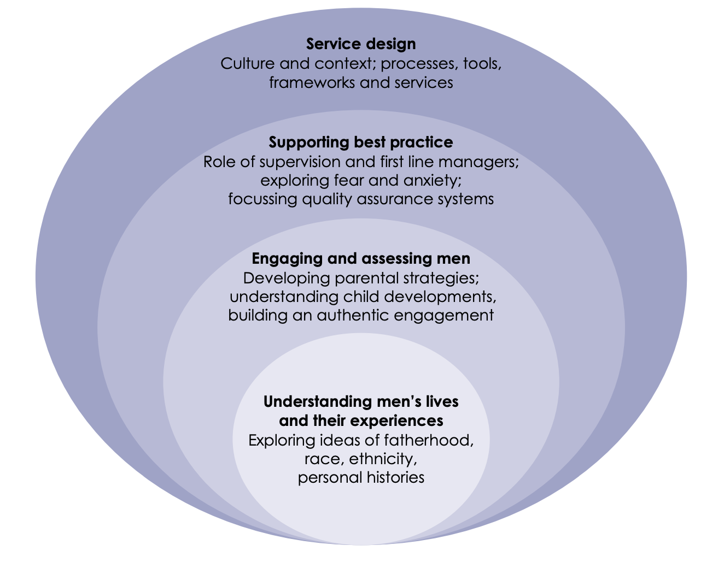
Four-tier model

Slide 15
Challenges to local safeguarding partners
The review recommends that all local safeguarding partnerships develop local strategies and action plans to support improved practice and effective service responses – in three areas:
Culture and Context
      HV commissioning and links with other services
      Leadership expectations about work with men
      Organisational support for working with violence and aggression
Processes
      Link-ups between adults and children’s services
      Response to Domestic Abuse Act
Tools, Frameworks and Services
      Workforce Development
      Supervision and staff management
      Improved engagement within social care

Slide 16
Conclusions
Men inflict some terrible and at times fatal injuries on babies - they are responsible for their actions and need to be held to account for them
Our knowledge and involvement with them is too often too weak and ineffective leading to non involvement and to binary judgements
Research and knowledge is thin in this area – cf CSA
Our work with mothers tends to be much more nuanced balanced and sophisticated
Men who are keen to be involved as fathers express difficulties in being seen and being heard
They can miss important inputs on how to deal with crying, sleeplessness, support for anxiety about fatherhood ('Silently Panicking’)

Slide 17
Conclusions
Other men wish to avoid their paternal duties and some of them, because of their circumstances and histories, represent a risk to their babies
Through fear, intimidation, threats, aggression or absenteeism they will often seek invisibility
The entirety of the system – from universal provision through to specialist child protection agencies, across both children’s and adults and up to and including the Courts - makes it too easy for them to succeed
Men are not, of course, invisible - they are unseen

Slide 18
Recommendations
In addition to the challenges to SPs, the review makes the following recommendations for the Government:
The engagement of fathers must be embedded in 5 key national programmes: The Leadsom Review; including Family Hubs; the Supporting Families Programme; Better Births and the Domestic Abuse Act implementation
Funding should be available to pilot ‘end-to-end’ projects to enable a number of local areas to re-design their systems and services from universal through to specialist to respond to this review
Funding should be available to fund a number of social care services and partners to develop better targeted child protection services
Funding should be available for further research into the backgrounds, characteristics and trigger factors of male perpetrators of serious harm.

Slide 19
Thank you!

Slide 20
Communications:
You can sign up to the mailing list online to receive Panel newsletters: http://eepurl.com/g6z_Tf
Follow @CSPR_Panel on Twitter
Email: Mailbox.NationalReviewPanel@education.gov.uk

